Slide 1

Cloud Security: Key Considerations Across AWS, Azure & GCP
Brad Voris
www.VictimOfTechnology.com / www.github.com/bvoris

Slide 2

Brad Voris, (a whole bunch of acronyms)
Technical Security Manager @ Pharma Company
25 years of experience IT/IS/CS
Undergrad in Cybersecurity @ Wilmington University
Certifications: CISSP, CISM, CCSP, CCSK, Network+, MTA, MCP, etc.
Co-Author 2 books: Intrusion Detection Guide and Essentials of Cybersecurity for Peerlyst
Cloud Security Alliance Zero Trust Training Contributor
NOT AN EXPERT
www.VictimOfTechnology.com / www.github.com/bvoris

Slide 3

Why Cloud Security Matters
45% of data breaches involve cloud-based infrastructure
$4.35M average cost of a cloud breach (Source: https://www.ibm.com/reports/data-breach)
Oh and the Oracle Data Breach… that just went public…
6M records exfiltrated from SSO and LDAP of Oracle Cloud (Source: https://www.cloudsek.com/blog***)
www.VictimOfTechnology.com / www.github.com/bvoris

Slide 4
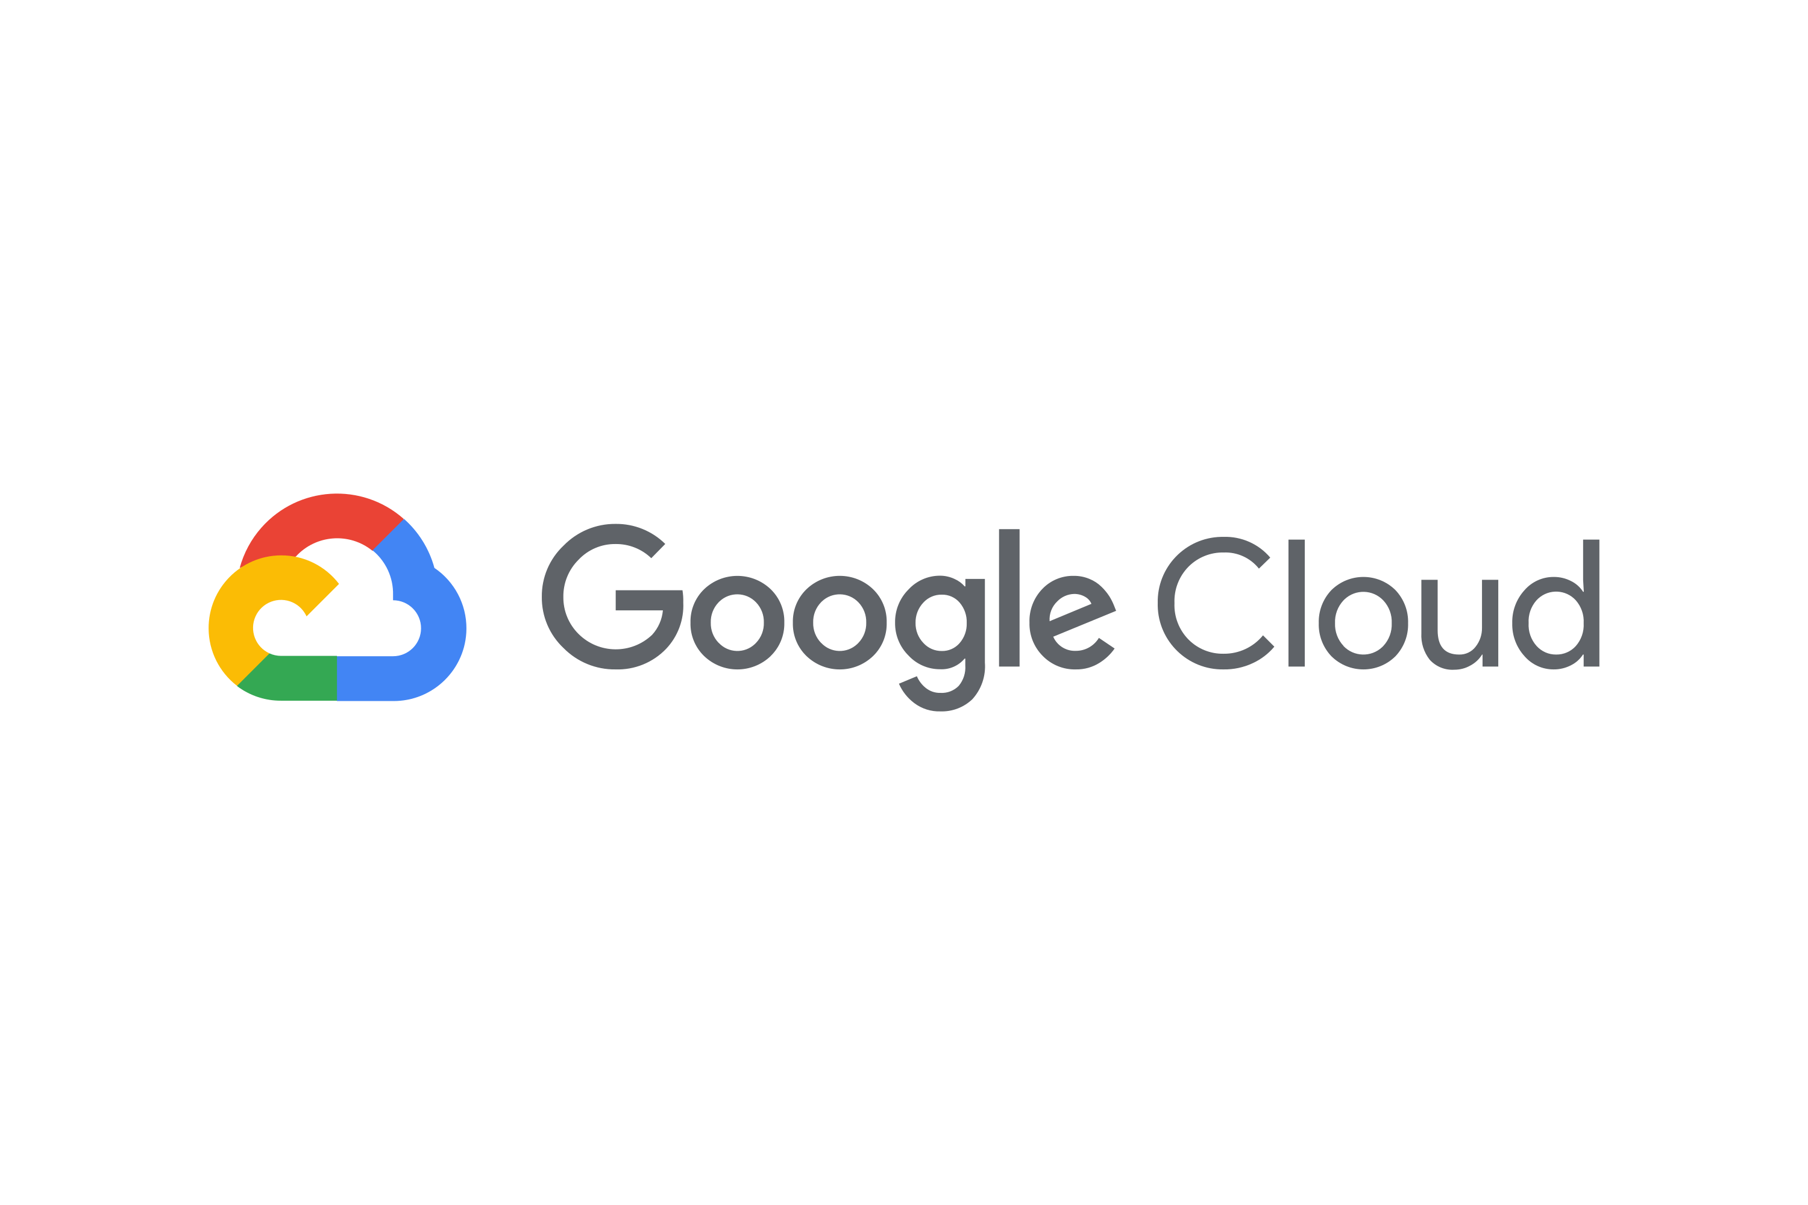
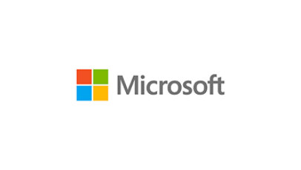
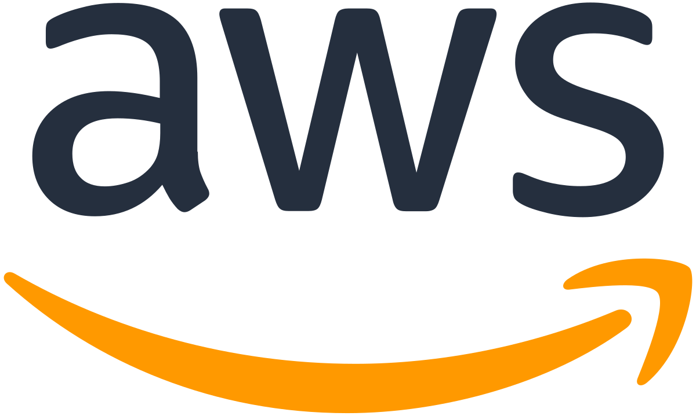
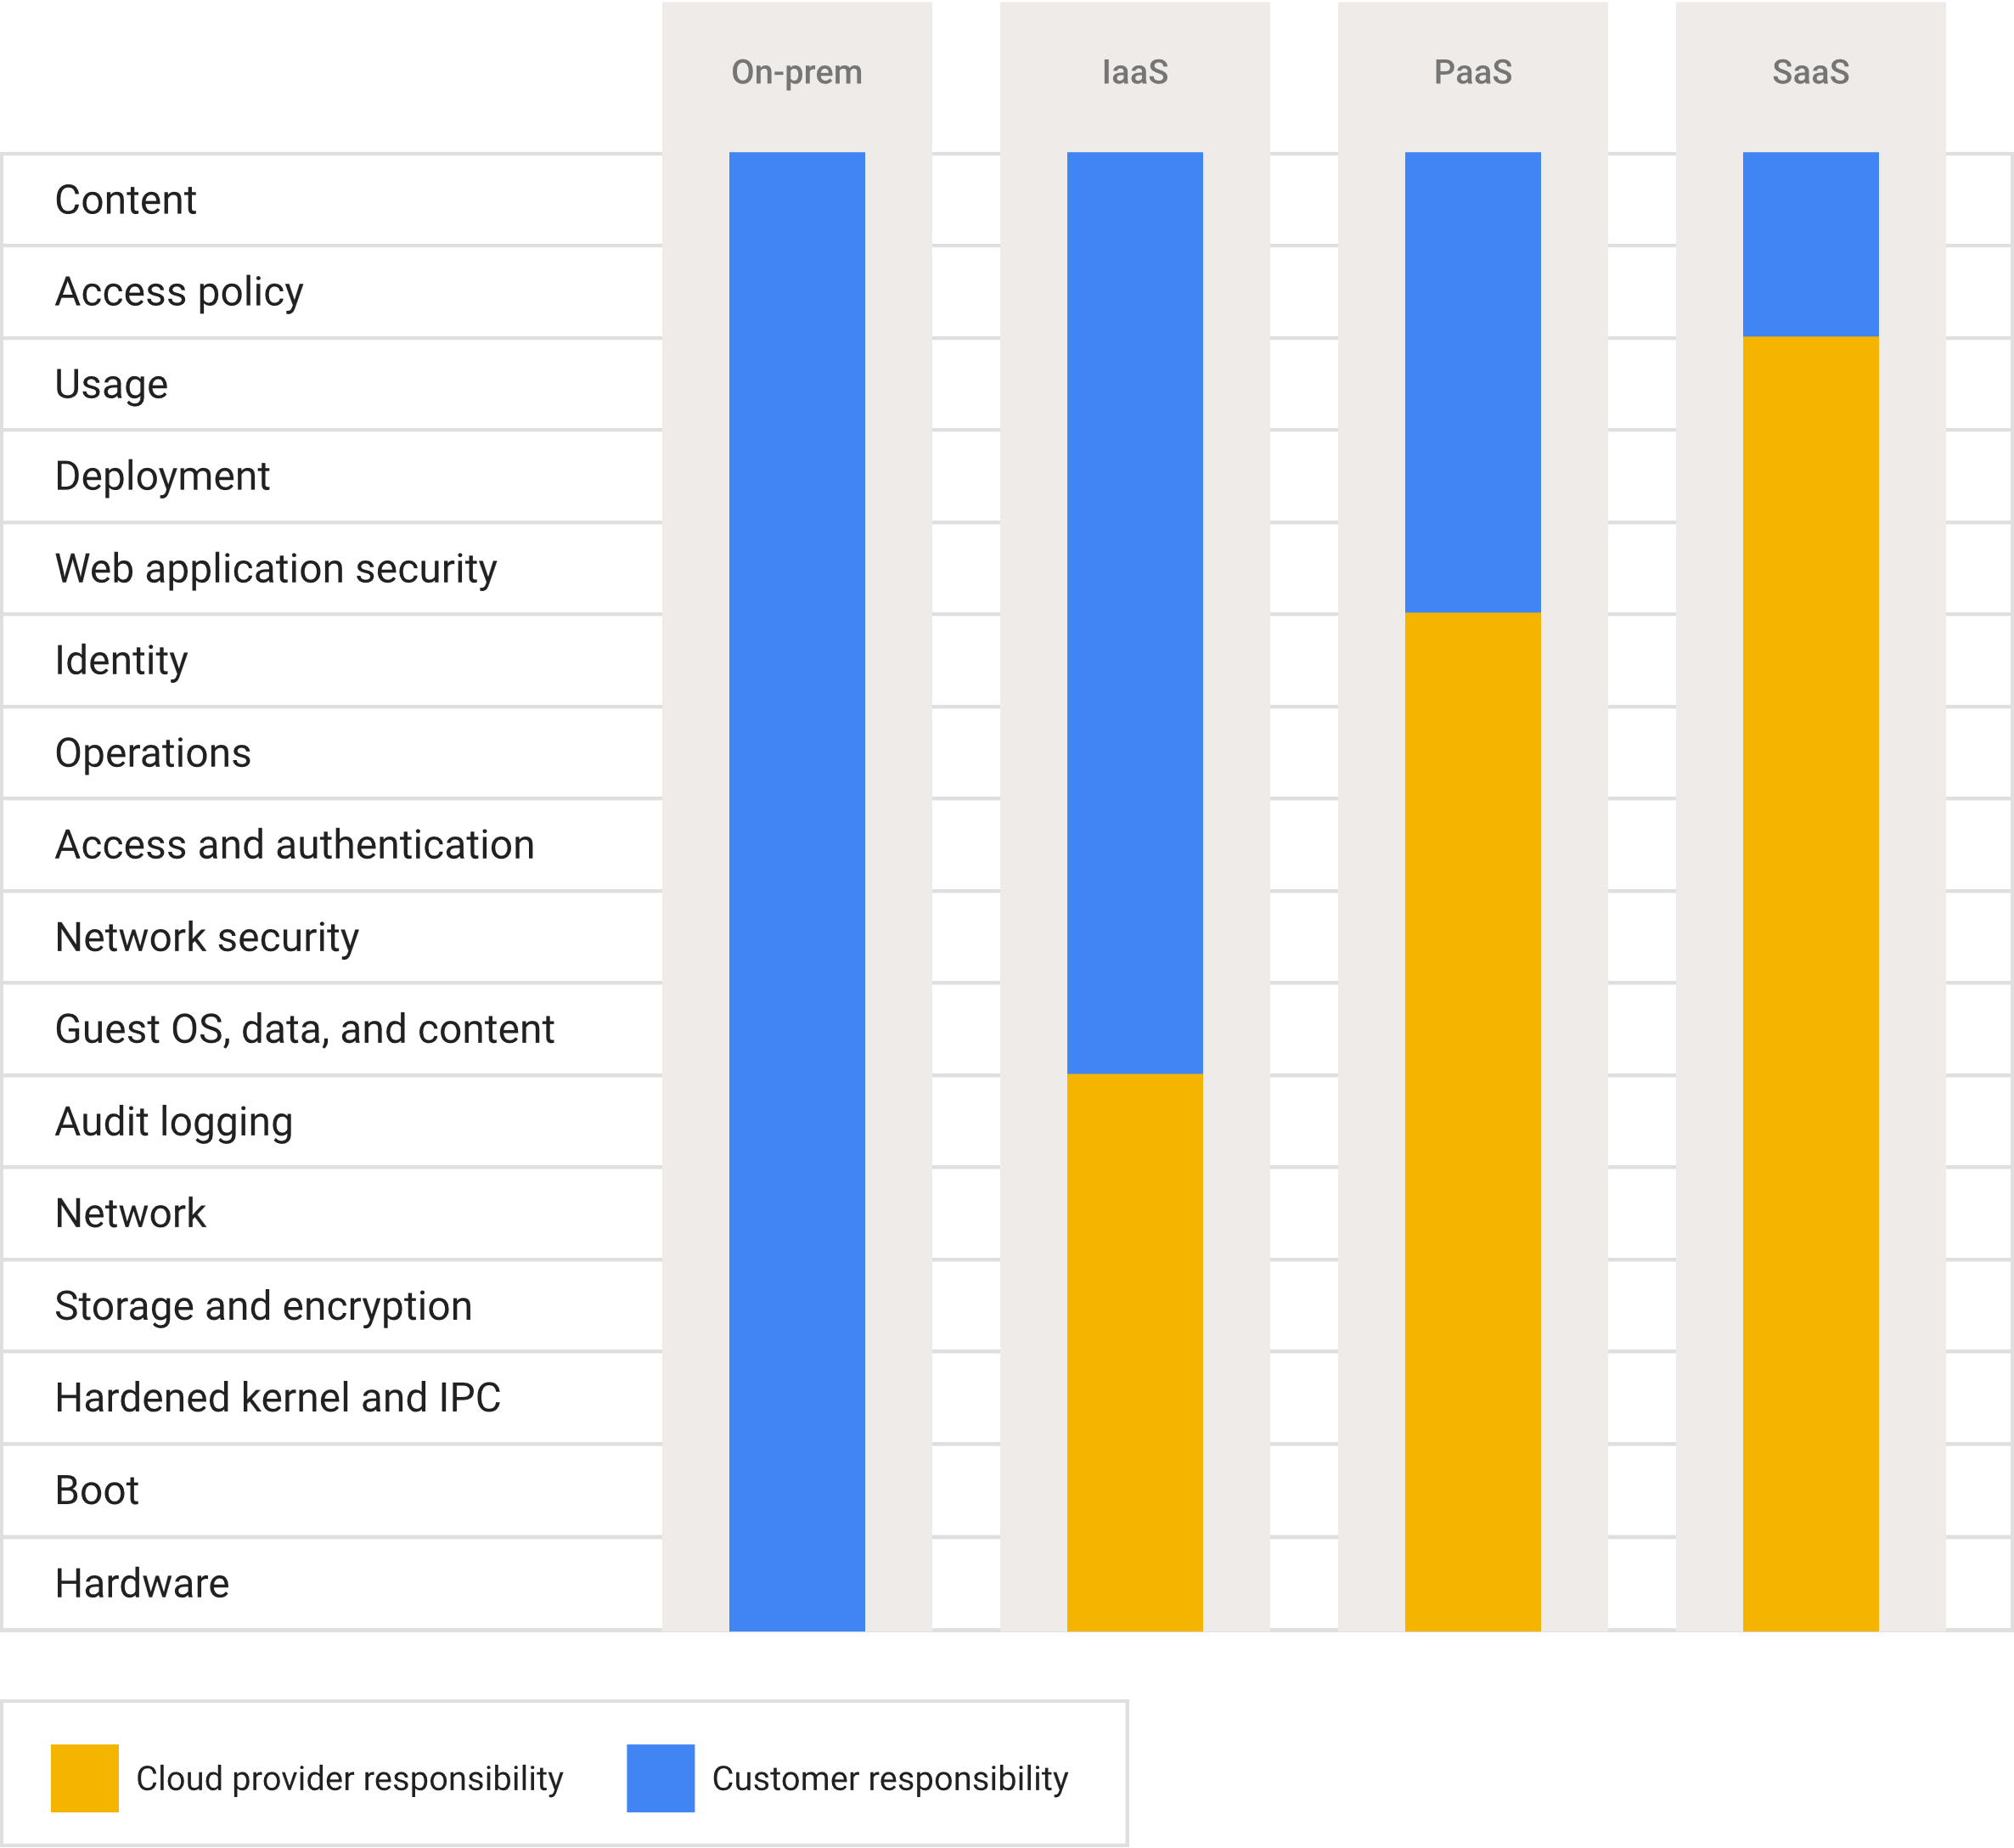
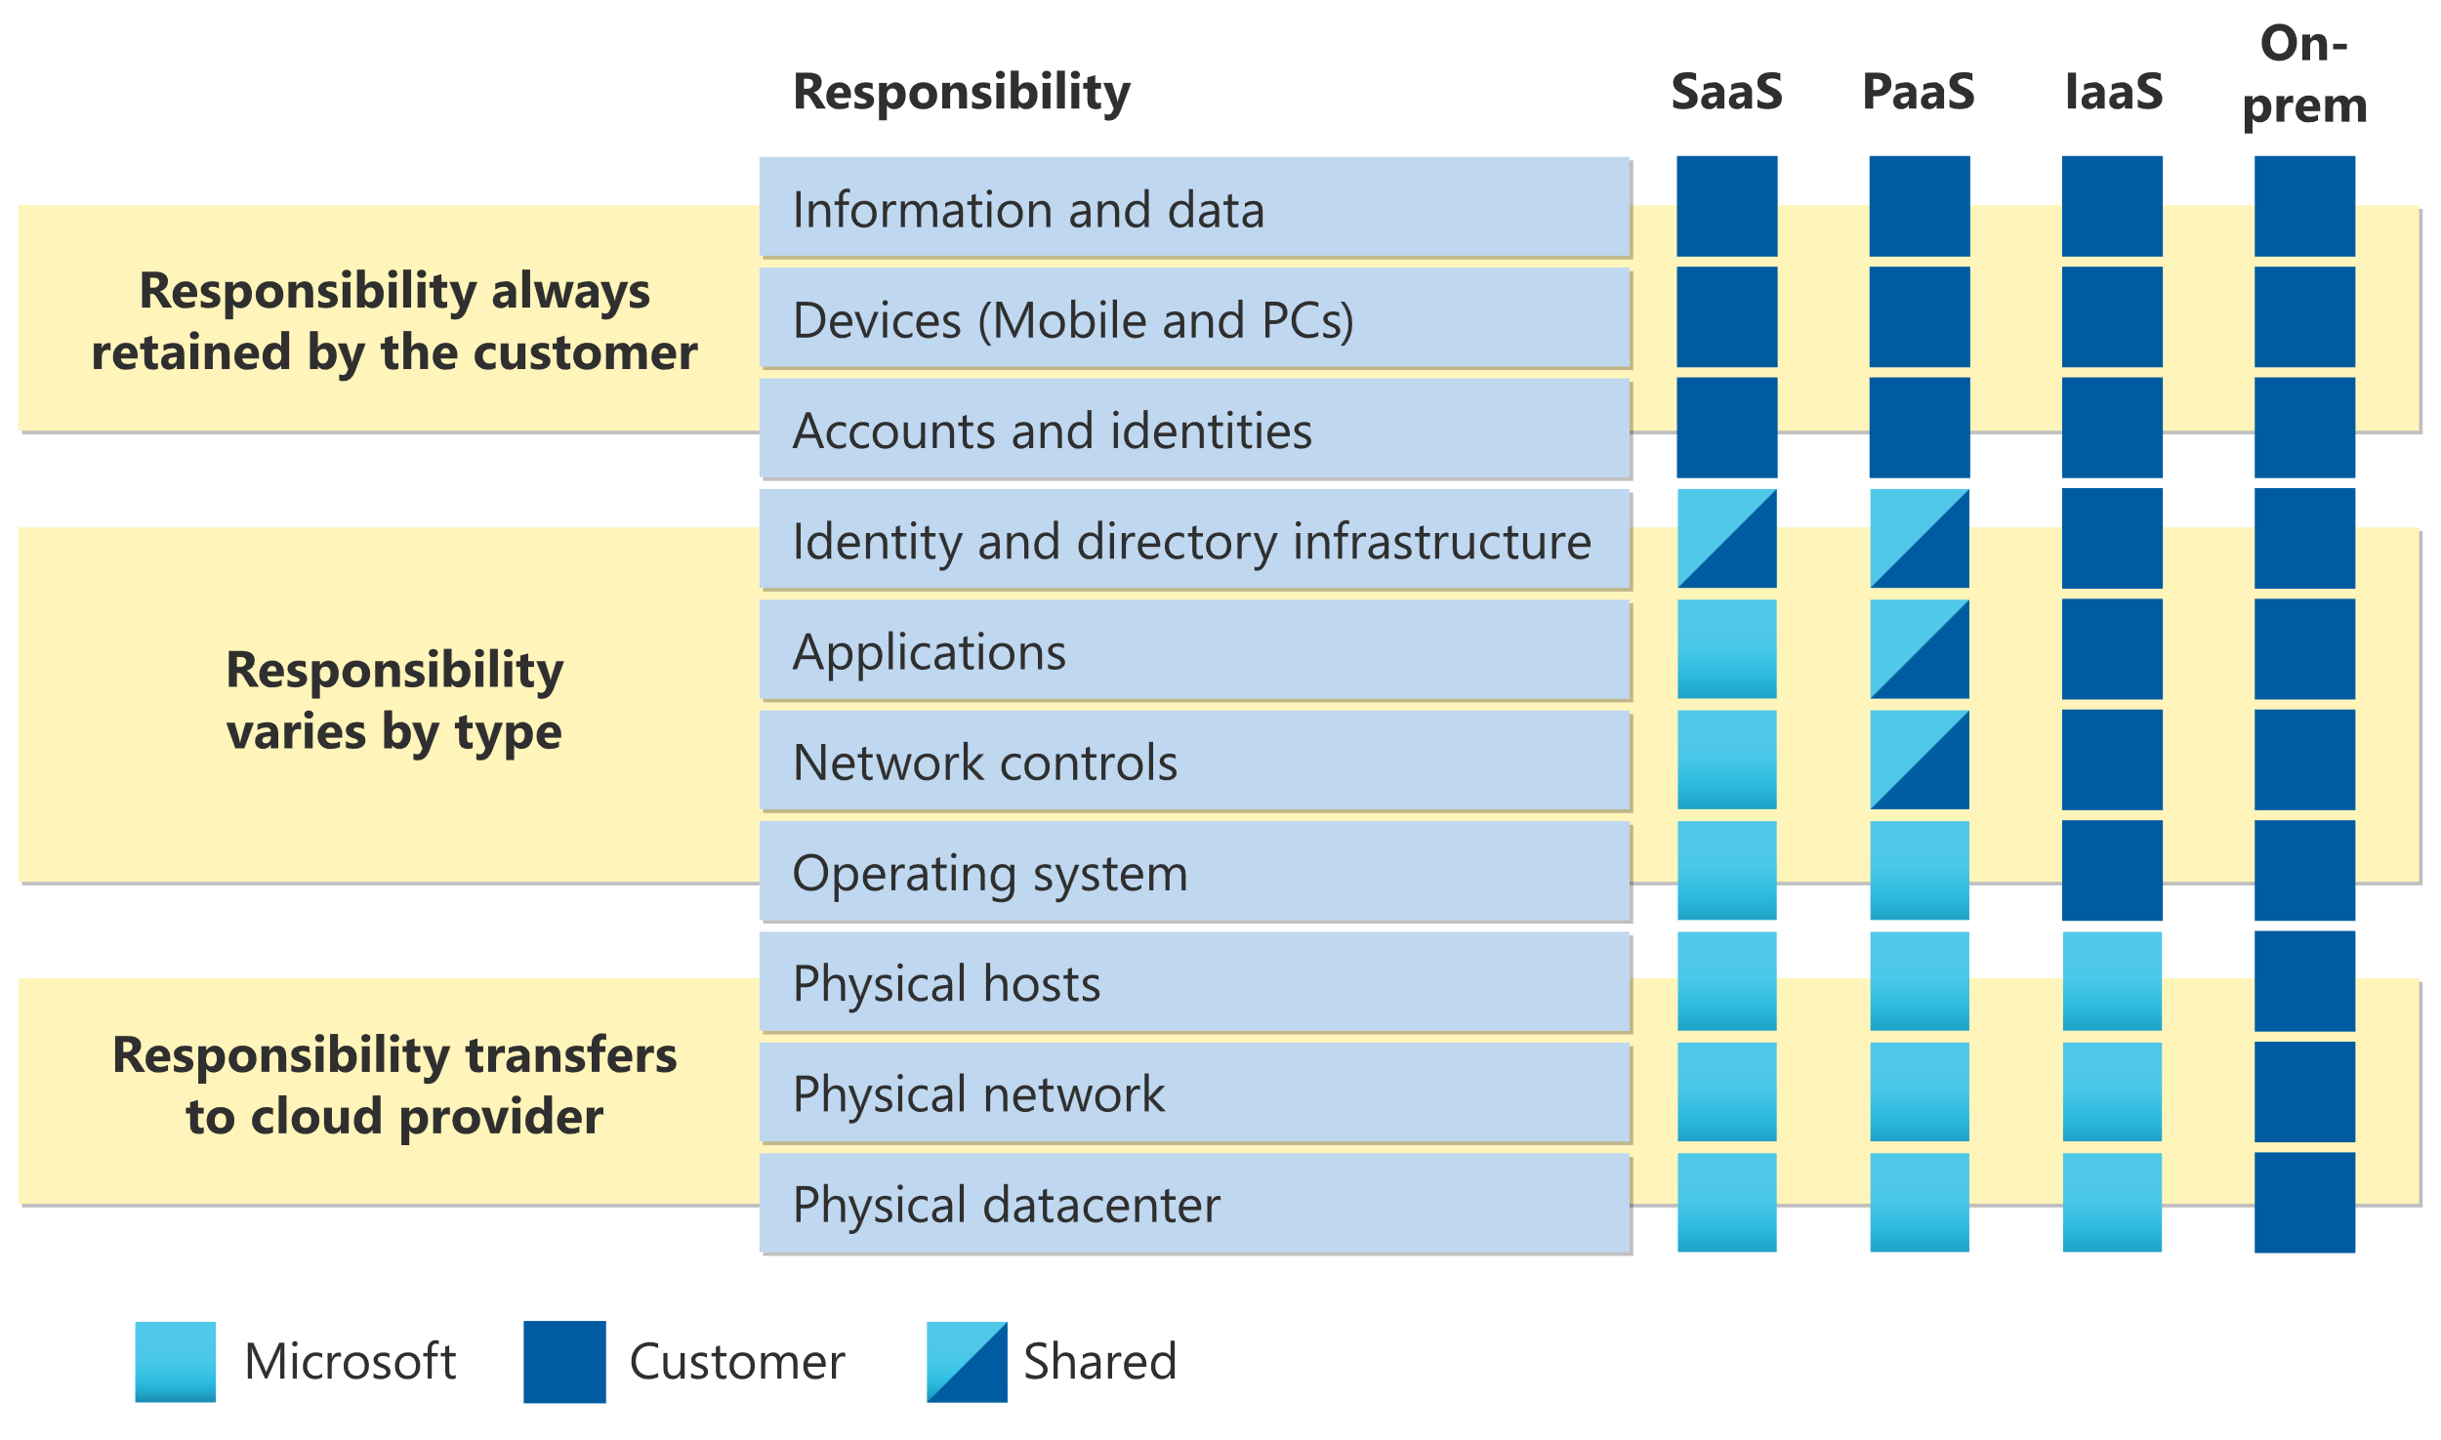
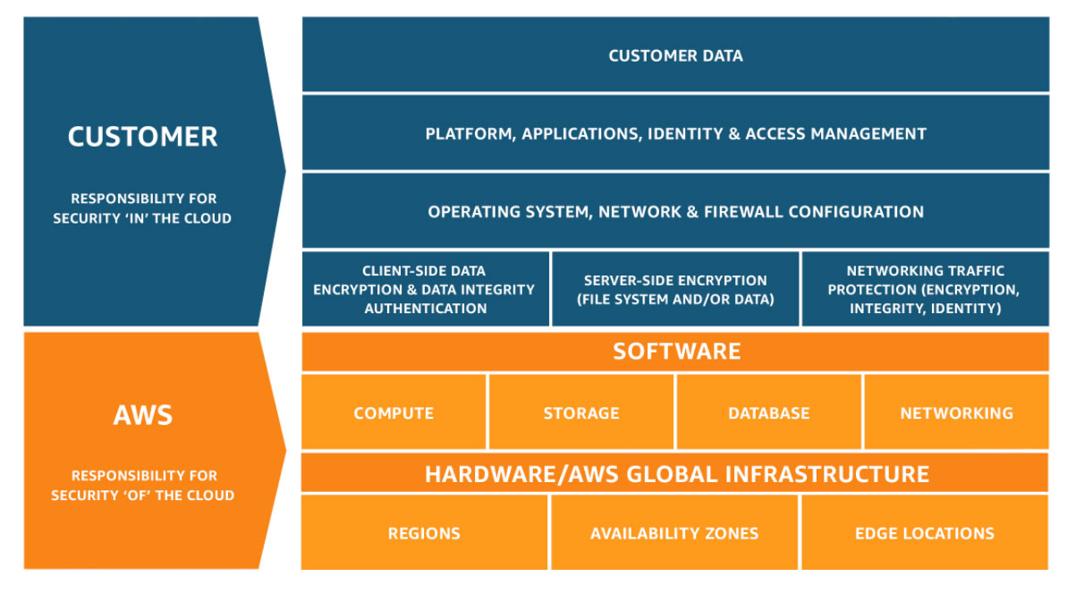
Shared Responsibility Model
www.VictimOfTechnology.com / www.github.com/bvoris

Slide 5
Identity and Access Management (IAM)
Key Considerations:
Principle of Least Privilege (PoLP) / Zero Trust Architecture (ZTA)
Multi-Factor Authentication (MFA)
Role-based access control (RBAC)
Attribute-based access controls (ABAC)
Architecture Components:
AWS: IAM, AWS Organizations, Cognito
Azure: Azure Active Directory (AAD) / Entra ID, Privileged Identity Management (PIM), Conditional Access
GCP: Cloud Identity Platform, Cloud IAM
Converged IDP vs. Non-Converged IDP
www.VictimOfTechnology.com / www.github.com/bvoris

Slide 6
Data Protection
Key Considerations:
Encryption at rest and in transit
Tokenization and masking
Backup and disaster recovery strategies
Architecture Components:
AWS: KMS, Secrets Manager, S3 encryption
Azure: Key Vault, Disk Encryption, SQL TDE
GCP: Cloud KMS, Cloud DLP, Cloud Storage encryption
Segmentation or data isolation
www.VictimOfTechnology.com / www.github.com/bvoris

Slide 7
Network Security
Key Considerations:
Firewalls and Network Security Groups
VPC/VNet segmentation / logging
Zero Trust Architecture
Architecture Components:
AWS: VPC, Security Groups, NACLs, AWS Shield (DDoS protection)
Azure: VNet, NSGs, Azure Firewall, DDoS Protection
GCP: VPC, Cloud Armor, Cloud Firewall
Web Application Firewalls / Proxies
www.VictimOfTechnology.com / www.github.com/bvoris

Slide 8
Compliance and Governance
Key Considerations:
Compliance with GDPR, HIPAA, SOC 2, ISO 27001
Cloud Security Posture Management (CSPM)
Centralized logging and auditing
Architecture Components:
AWS: Config, CloudTrail, Security Hub, Audit Manager
Azure: Policy, Security Center, Azure Monitor
GCP: Security Command Center, Cloud Audit Logs, Forseti Security

Slide 9

Threat Detection and Response
Key Considerations:
Automated threat detection
SIEM and SOAR integration
Incident response automation
Architecture Components:
AWS: GuardDuty, Detective, AWS WAF
Azure: Sentinel, Defender for Cloud
GCP: Chronicle SIEM, Security Command Center, Cloud IDS

Slide 10
Best Practices and Recommendations
Key Considerations:
Adopt Multi-layered Security: Defense-in-depth approach
Multi-cloud approach if possible
Implement Zero Trust Architecture Methodology
Automate Security: Infrastructure as Code (IaC)
Regular Audits & Penetration Testing: Identify vulnerabilities
Backup and Disaster Recovery: Ensure redundancy and failover strategies

Slide 11
Cloud Security is a Shared Responsibility
Q & A

